Slide 1

Exploratory Data Analysis
G2M Insights for Cab Investment Firm
05/20/2022

Slide 2
Agenda
Executive Summary
Problem Statement
Approach
EDA
EDA Summary
Recommendations

Slide 3
Executive Summary
‘Yellow Cab’ had more male customers and higher net margin % and mainly kept expanding its business in big cities.
'Yellow Cab' had more transactions and obviously higher net margin percentages during the whole year across years from 2016 to 2018.
It is recommended to invest in the ‘Yellow Cab’.

Slide 4
Problem Statement
Client:
  XYZ is a private equity firm in US. Due to remarkable growth in the Cab Industry in last few years and multiple key players in the market, it is planning for an investment in Cab industry.
Objective:
  Help understand the cab industry
  Provide Go-to-Market insights for identifying the right company to make investment.
Business Problems:
  Is there any seasonality in number of customers using the cab service?
  Which company has maximum cab users at a particular time period?
  Does margin proportionally increase with increase in number of customers?

Slide 5
Approach
Data:
  Files: Cab_Data.csv, Customer_ID.csv, Transaction_ID.csv, City.csv
  Records: 359,392 (After merge)
  Timeframe: 01/31/2016 - 12/31/2018
  Features: 14 (After merge)
Methods:
  Dedupe Validation
  Descriptive Analysis
  Correlation Analysis
  Contextual Analysis

Slide 6
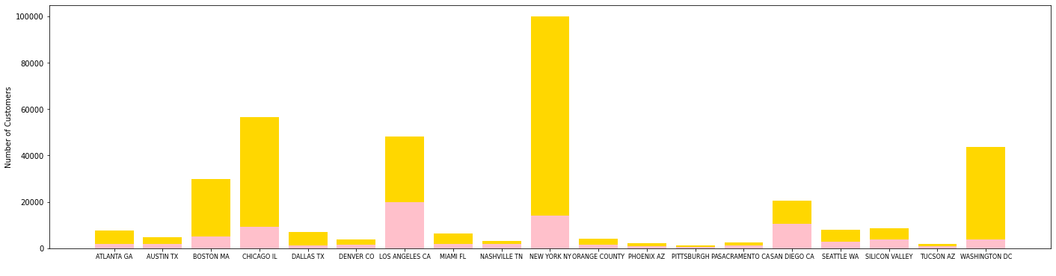
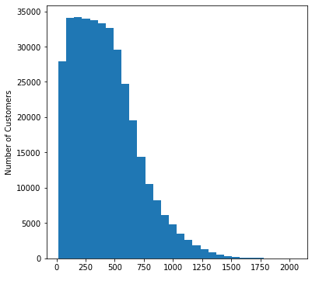
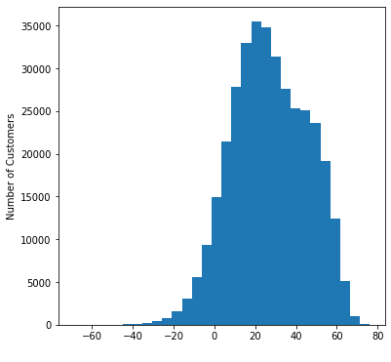
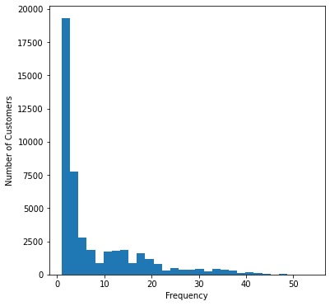
EDA - Descriptive Analysis

Slide 7
EDA - Correlation Analysis
X | Y | P-Value | Coefficients
Gender | Company | 0.017 | -
Gender | City | 0.0 | -
Company | City | 0.0 | -
Cost of Trip | KM Travelled | - | 0.98
Cost of Trip | Price Charged | - | 0.90
Price Charged | KM Travelled | - | 0.88
Company | Net Margin % | 0.0 | -
City | Net Margin % | 0.0 | -
Gender | Frequency | 0.0 | -
City | Frequency | 0.0 | -

Slide 8
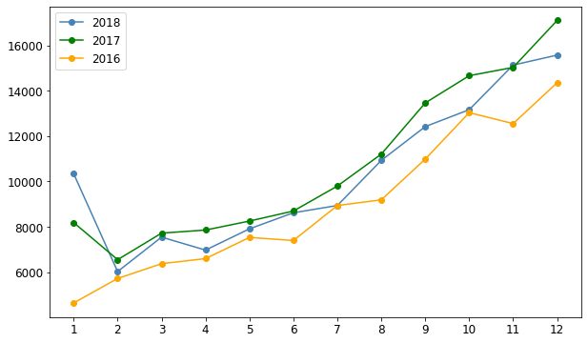
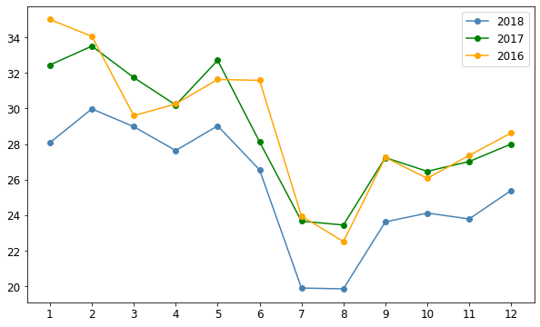
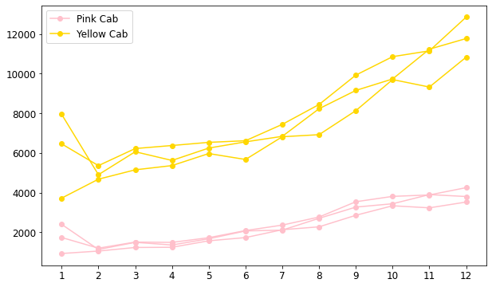
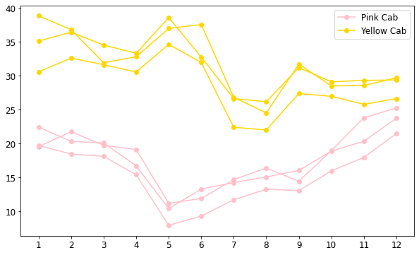
EDA - Contextual Analysis

Slide 9
EDA Summary
‘Yellow Cab’ has more male customers and higher net margin %.
Big cities have more male customers, ‘Yellow Cab’, and higher net margin % except Chicago.
Female tend to have higher frequency using cab service.
Obvious seasonality in numbers of transactions and average net margin percentages within years from 2016 to 2018, without much differences from year to year.
'Yellow Cab' had more transactions during the whole year across years from 2016 to 2018 rather than the company 'Pink Cab', especially with more rapidly-increasing trends in the latter parts of years.
'Yellow Cab' had higher net margin percentages during the whole year across years from 2016 to 2018 rather than the company 'Pink Cab' obviously.

Slide 10
Recommendations
In conclusion, we recommend ‘Yellow Cab’ for investment.

Slide 11
Thank You

